Slide 1
cs5460/6460: Operating Systems Lecture: System boot
Anton Burtsev
February, 2024

Slide 2
What happens when we turn on the power?
Well it's complicated
Intel SGX Explained is a good start (Section 2.13 [1])
At a high-level a sequence of software pieces initializes the platform
Management engine (ME), microcode, firmware (BIOS), bootloader

Slide 3
The most important thing: the OS is not the only software running on the machine
And not the most privileged
Today, at least two layers sit underneath the OS/hypervisor
System Management Mode (SMM) (ring -2)
Runs below the hypervisor/OS
Intel Management Engine and Intel Innovation Engine (ring -3)

Slide 4
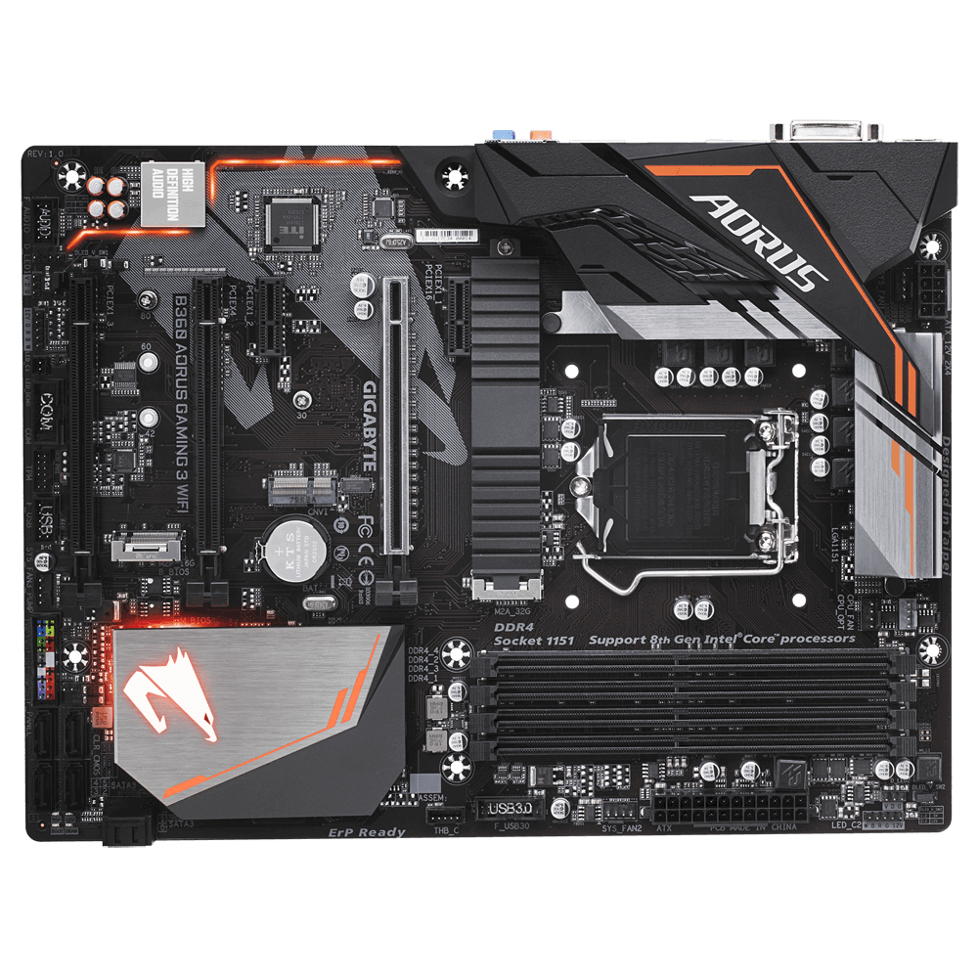
B360 AORUS Motherboard

Slide 5
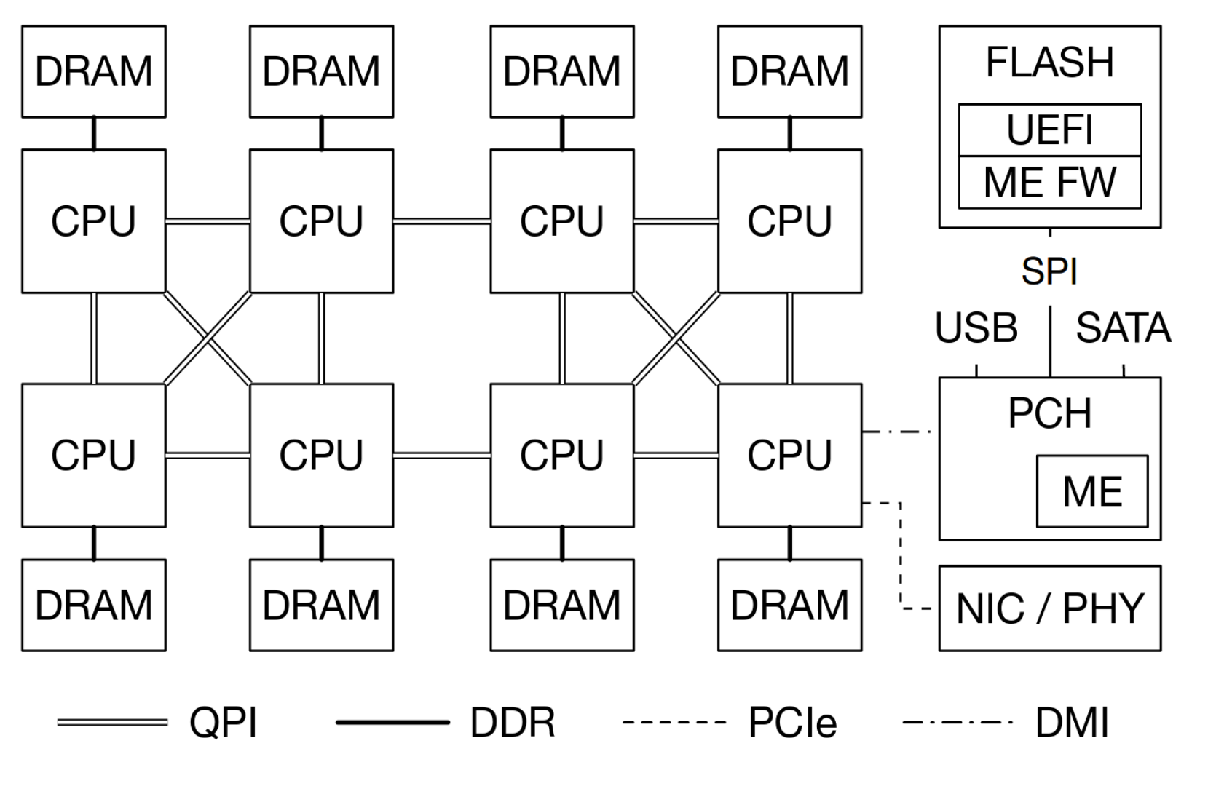
PC motherboard components

Slide 6
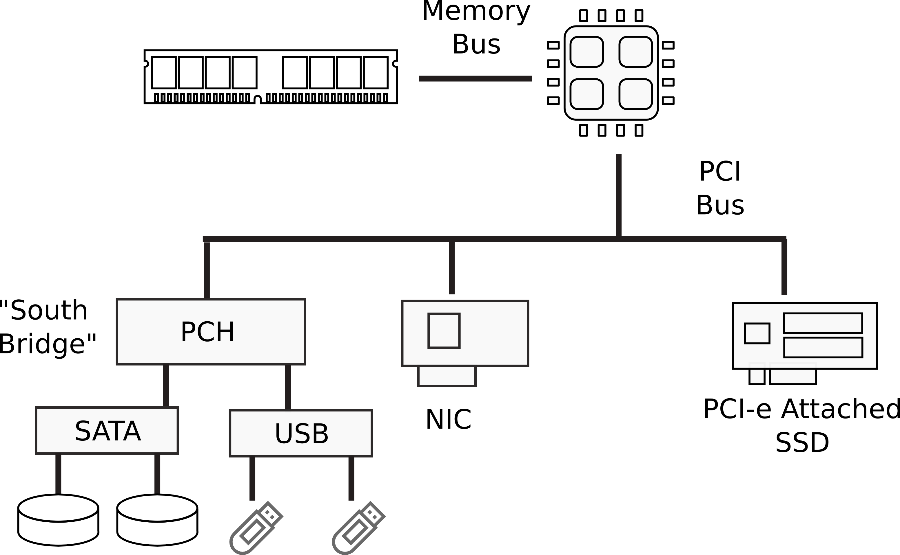
I/O Devices

Slide 7
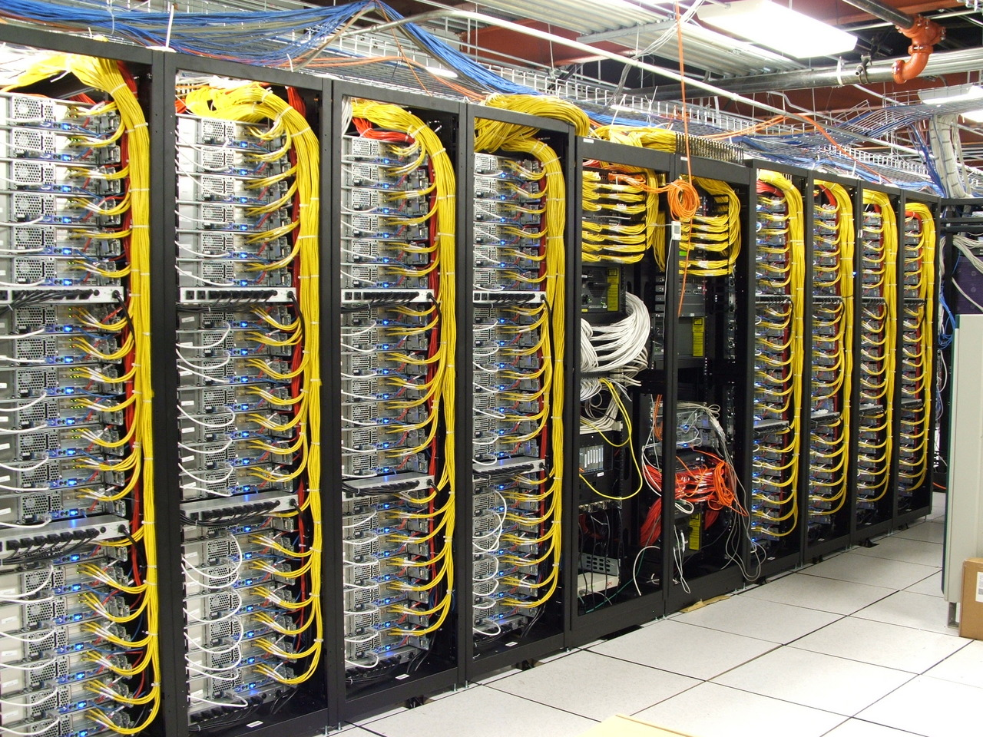
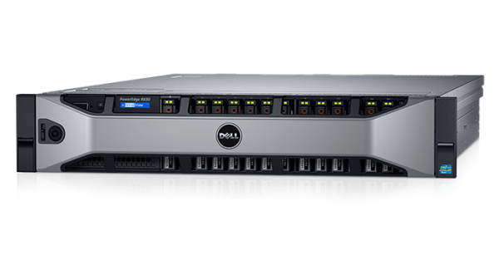
Dell R830 4-socket server
Dell Poweredge R830 System Server with 2 sockets on the main floor and 2 sockets on the expansion
http://www.dell.com/support/manuals/us/en/19/poweredge-r830/r830_om/supported-configurations-for-the-poweredge-r830-system?guid=guid-01303b2b-f884-4435-b4e2-57bec2ce225a&lang=en-us

Slide 8
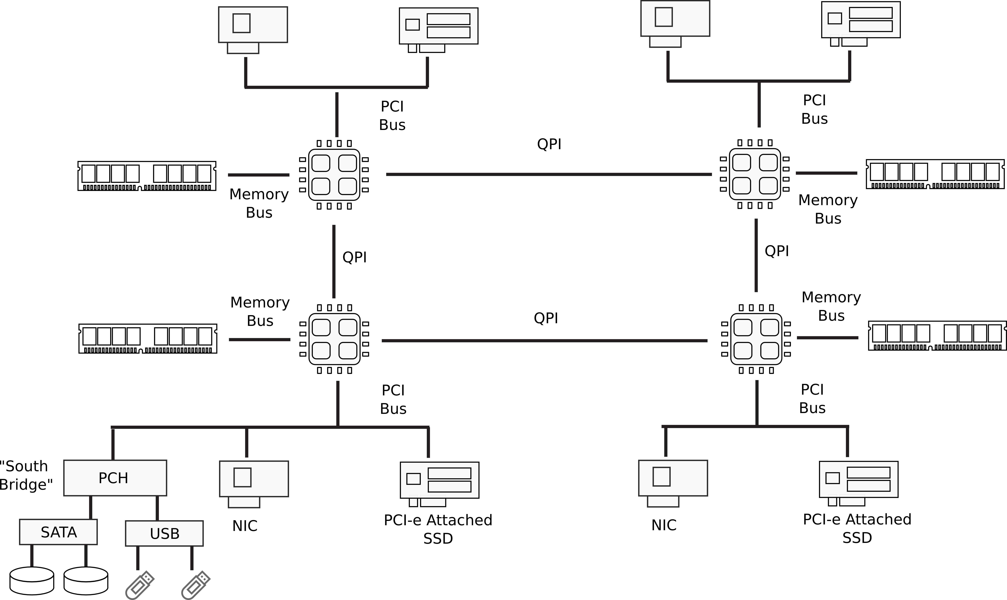
Multi-socket machines

Slide 9
PC motherboard components

Slide 10
PCH – Platform Controller Hub

Slide 11
B360 AORUS Motherboard

Slide 12
ME gets power before CPUs

Slide 13
Intel Management Engine (ME)
Full-featured computer
Intel Quark x86-based 32-bit CPU
Internal RAM (1.7MB)
Can access all DRAM via DMA
Can control boot chain
Can access network interface (NIC) on the motherboard
Has it’s own MAC and IP address
Via System Management Bus (SMBus)
Or an ATM compatible NIC
Connected to the power supply
Stays on as long as power is provided to power supply

Slide 14
ME: Theft prevention use-case
In S5 (computer off) ME cannot access DRAM
DRAM is off
But ME can use its internal memory
ME can disable a stolen laptop equipped with cellular modem remotely
As long as power is connected
And cell network has signal

Slide 15
Intel Management Engine (ME)
All modern motherboard chips contain ME
Part of Active Management Technology (AMT)
Convenient way for administrators to fix your machine remotely
Obviously a huge opportunity for an attack

Slide 16
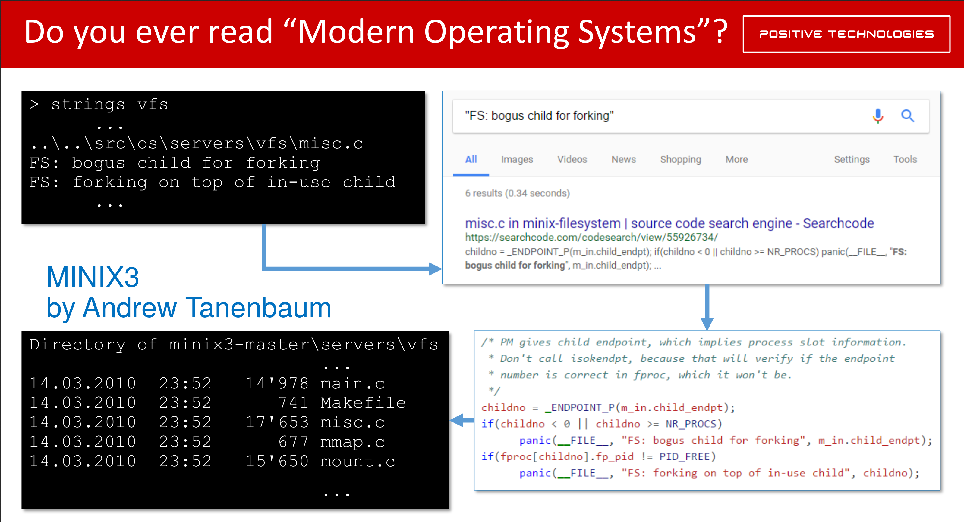
What’s running there?

Slide 17
ME starts first
Reads its initialization code from the BIOS chip
Via the SPI bus

Slide 18
Bootstrap processor (BSP)
One of the logical processors is chosen as bootstrap processor (BSP)
Will start initialization
Others become “application processors” (AP)
Waiting for a special interrupt from the BSP

Slide 19
BSP starts reading BIOS
Executes instructions stored in the BIOS chip
An interesting detail is that BSP starts with DRAM disabled
Hence there is no stack to call functions
What can be done?

Slide 20
BSP starts without DRAM
Custom-written assembly code that uses no stack
Or a ROMCC compiler
Generates code from C that uses no stack
Used in the coreboot project

Slide 21
Cache-as-RAM
Use CPU caches as temporary replacement for RAM
Initialize DRAM
Copy BIOS firmware into DRAM and continue

Slide 22
BIOS firmware
Initialize
Interrupt controllers
Devices, e.g., network interfaces
If one of PCI devices contains “option ROM” load and execute it
Network cards may contain iPXE ROM
Implement boot from the network host

Slide 23
System Management Mode
Another compartment that runs underneath your OS or a hypervisor
Initialized by BIOS
Protected with hardware memory mechanisms
OS cannot access this region of memory
Runs under your OS and the hypervisor
Receives interrupts periodically, can take over the entire system any time
No way to disable

Slide 24
BIOS loads the boot loader
BIOS ends by loading a boot loader
Modern BIOSes can load the boot loader from a variety of sources (hard disks, USB drives, optical disks)
Default way is to load the first sector (512 bytes) from disk into the memory location at 0x7c00
BIOS then starts executing instructions at the address 0x7c00
This is exactly what we see when we run xv6 under QEMU
QEMU emulates hardware: runs BIOS, follows the same protocol

Slide 25
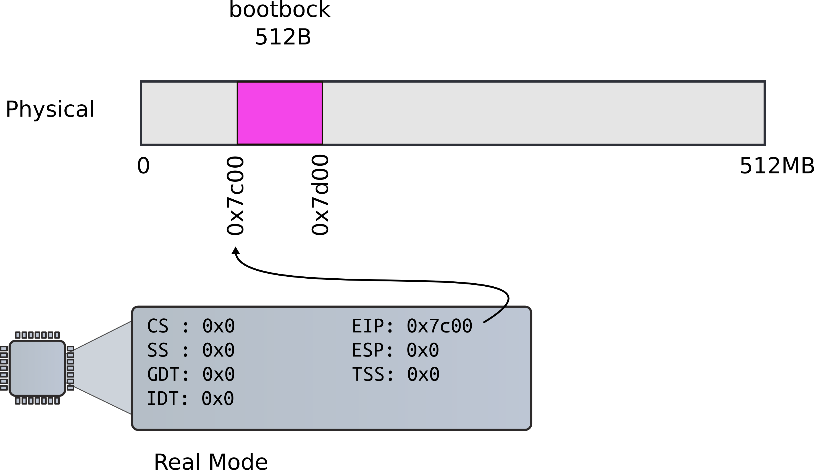
BIOS loads bootloader

Slide 26
Outline of the boot sequence

Slide 27
Outline of the boot sequence
Setup segments (data and code)
Switch to protected mode
Load GDT (segmentation is on)
Setup stack (to call C functions)
Load kernel from disk
Setup first page table
2 entries [ 0 : 4MB ] and [ 2GB : (2GB + 4MB) ]
Setup high-address stack
Jump to main()

Slide 28
Bootloader starts
9111 start:
9112 cli # BIOS enabled interrupts; disable
9113
9114 # Zero data segment registers DS,ES,and
SS.
9115 xorw %ax,%ax # Set %ax to zero
9116 movw %ax,%ds # −> Data Segment
9117 movw %ax,%es # −> Extra Segment
9118 movw %ax,%ss # −> Stack Segment
xv6/bootasm.S [bootloader]

Slide 29
Why start happens to be 0x7c00?
9111 start:
9112 cli # BIOS enabled interrupts; disable
9113
xv6/bootasm.S [bootloader]

Slide 30
Linker is instructed to link the boot block code in the Makefile
9111 start:
9112 cli # BIOS enabled interrupts; disable
9113
bootblock: bootasm.S bootmain.c
$(CC) $(CFLAGS) -fno-pic -O -nostdinc -I. -c bootmain.c
$(CC) $(CFLAGS) -fno-pic -nostdinc -I. -c bootasm.S
$(LD) $(LDFLAGS) -N -e start -Ttext 0x7C00 -o bootblock.o bootasm.o bootmain.o
$(OBJDUMP) -S bootblock.o > bootblock.asm
$(OBJCOPY) -S -O binary -j .text bootblock.o bootblock
./sign.pl bootblock
xv6/Makefile

Slide 31
Switch to protected mode
Switch from real to protected mode
Use a bootstrap GDT that makes virtual addresses map directly to physical addresses so that the effective memory map doesn’t change during the transition.
9141 lgdt gdtdesc
9142 movl %cr0, %eax
9143 orl $CR0_PE, %eax
9144 movl %eax, %cr0
xv6/bootasm.S [bootloader]

Slide 32
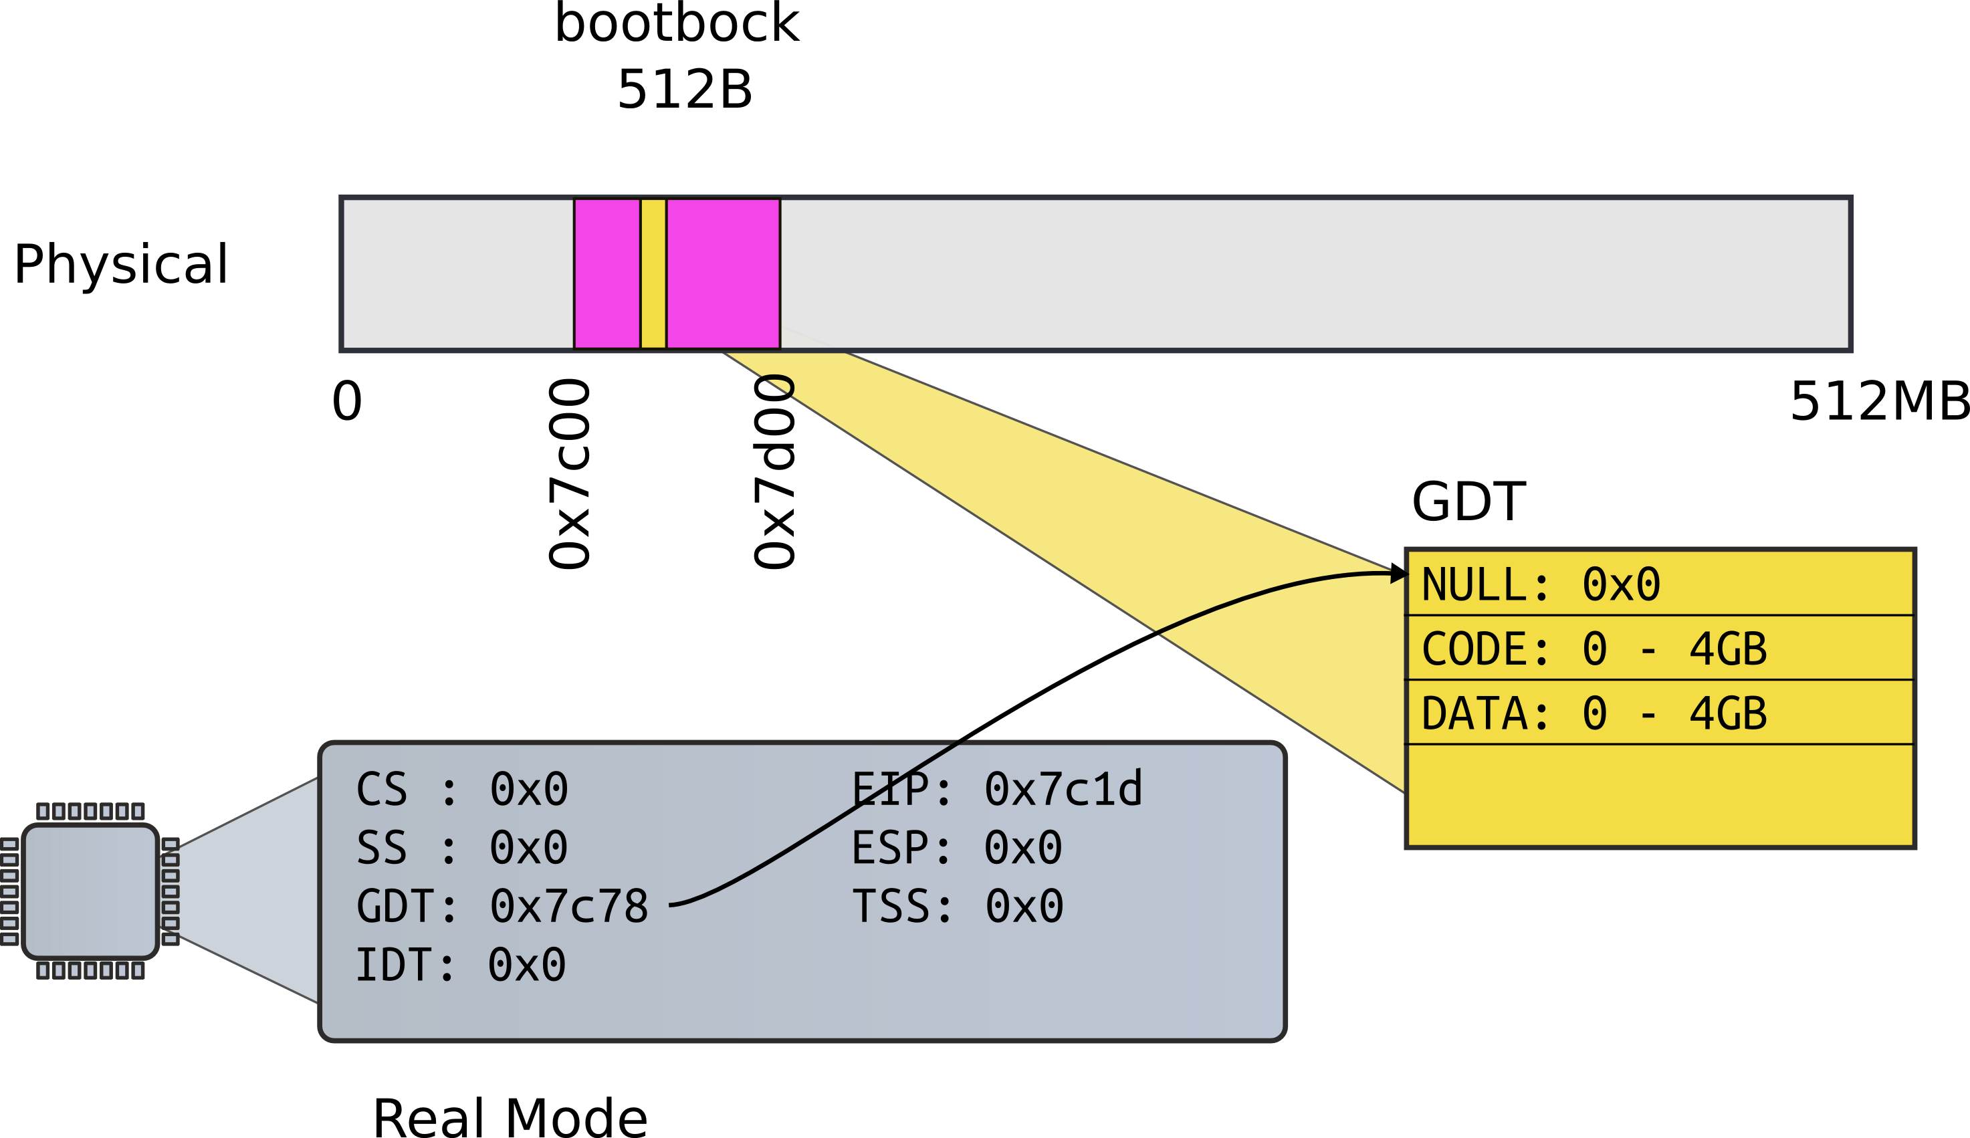
Load GDT

Slide 33
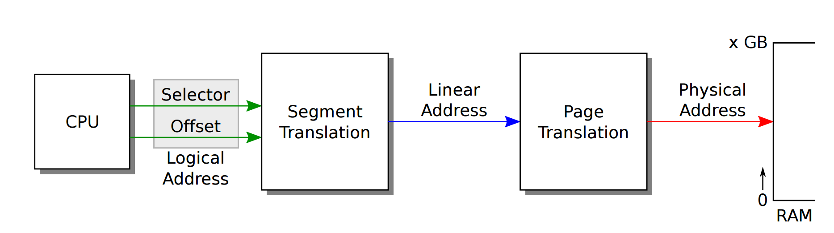
Recap: complete address translation

Slide 34
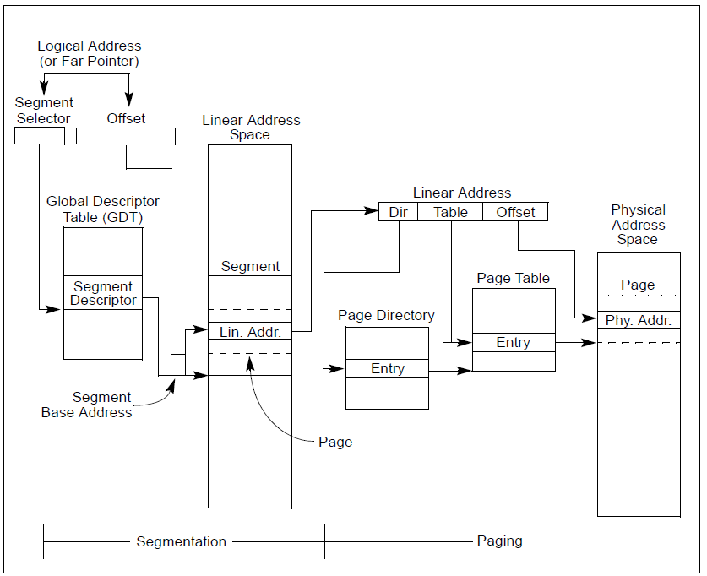

Slide 42
How GDT is defined
9180 # Bootstrap GDT
9181 .p2align 2 # force 4 byte alignment
9182 gdt:
9183 SEG_NULLASM # null seg
9184 SEG_ASM(STA_X|STA_R, 0x0, 0xffffffff) # code seg
9185 SEG_ASM(STA_W, 0x0, 0xffffffff) # data seg
9186
9187 gdtdesc:
9188 .word (gdtdesc − gdt − 1) # sizeof(gdt) − 1
9189 .long gdt
xv6/bootasm.S [bootloader]

Slide 43
How GDT is defined
9180 # Bootstrap GDT
9181 .p2align 2 # force 4 byte alignment
9182 gdt:
9183 SEG_NULLASM # null seg
9184 SEG_ASM(STA_X|STA_R, 0x0, 0xffffffff) # code seg
9185 SEG_ASM(STA_W, 0x0, 0xffffffff) # data seg
9186
9187 gdtdesc:
9188 .word (gdtdesc − gdt − 1) # sizeof(gdt) − 1
9189 .long gdt
xv6/bootasm.S [bootloader]

Slide 44
Actual switch
Use long jump to change code segment
9153 ljmp $(SEG_KCODE<<3), $start32
Explicitly specify code segment, and address
Segment is 0b1000 (0x8)
xv6/bootasm.S [bootloader]

Slide 45
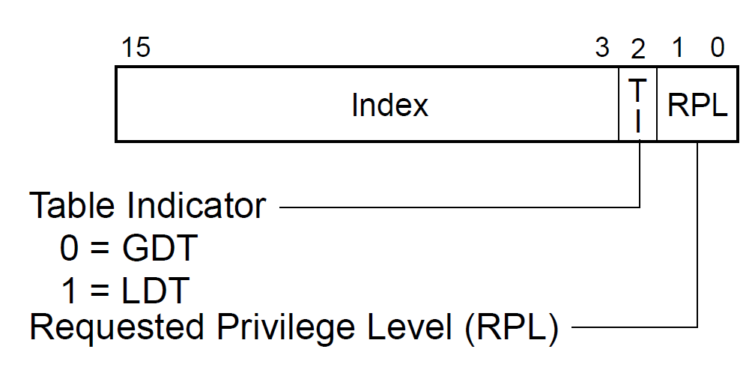
Why CS is 0x8, not 0x1?
Segment selector:

Slide 46
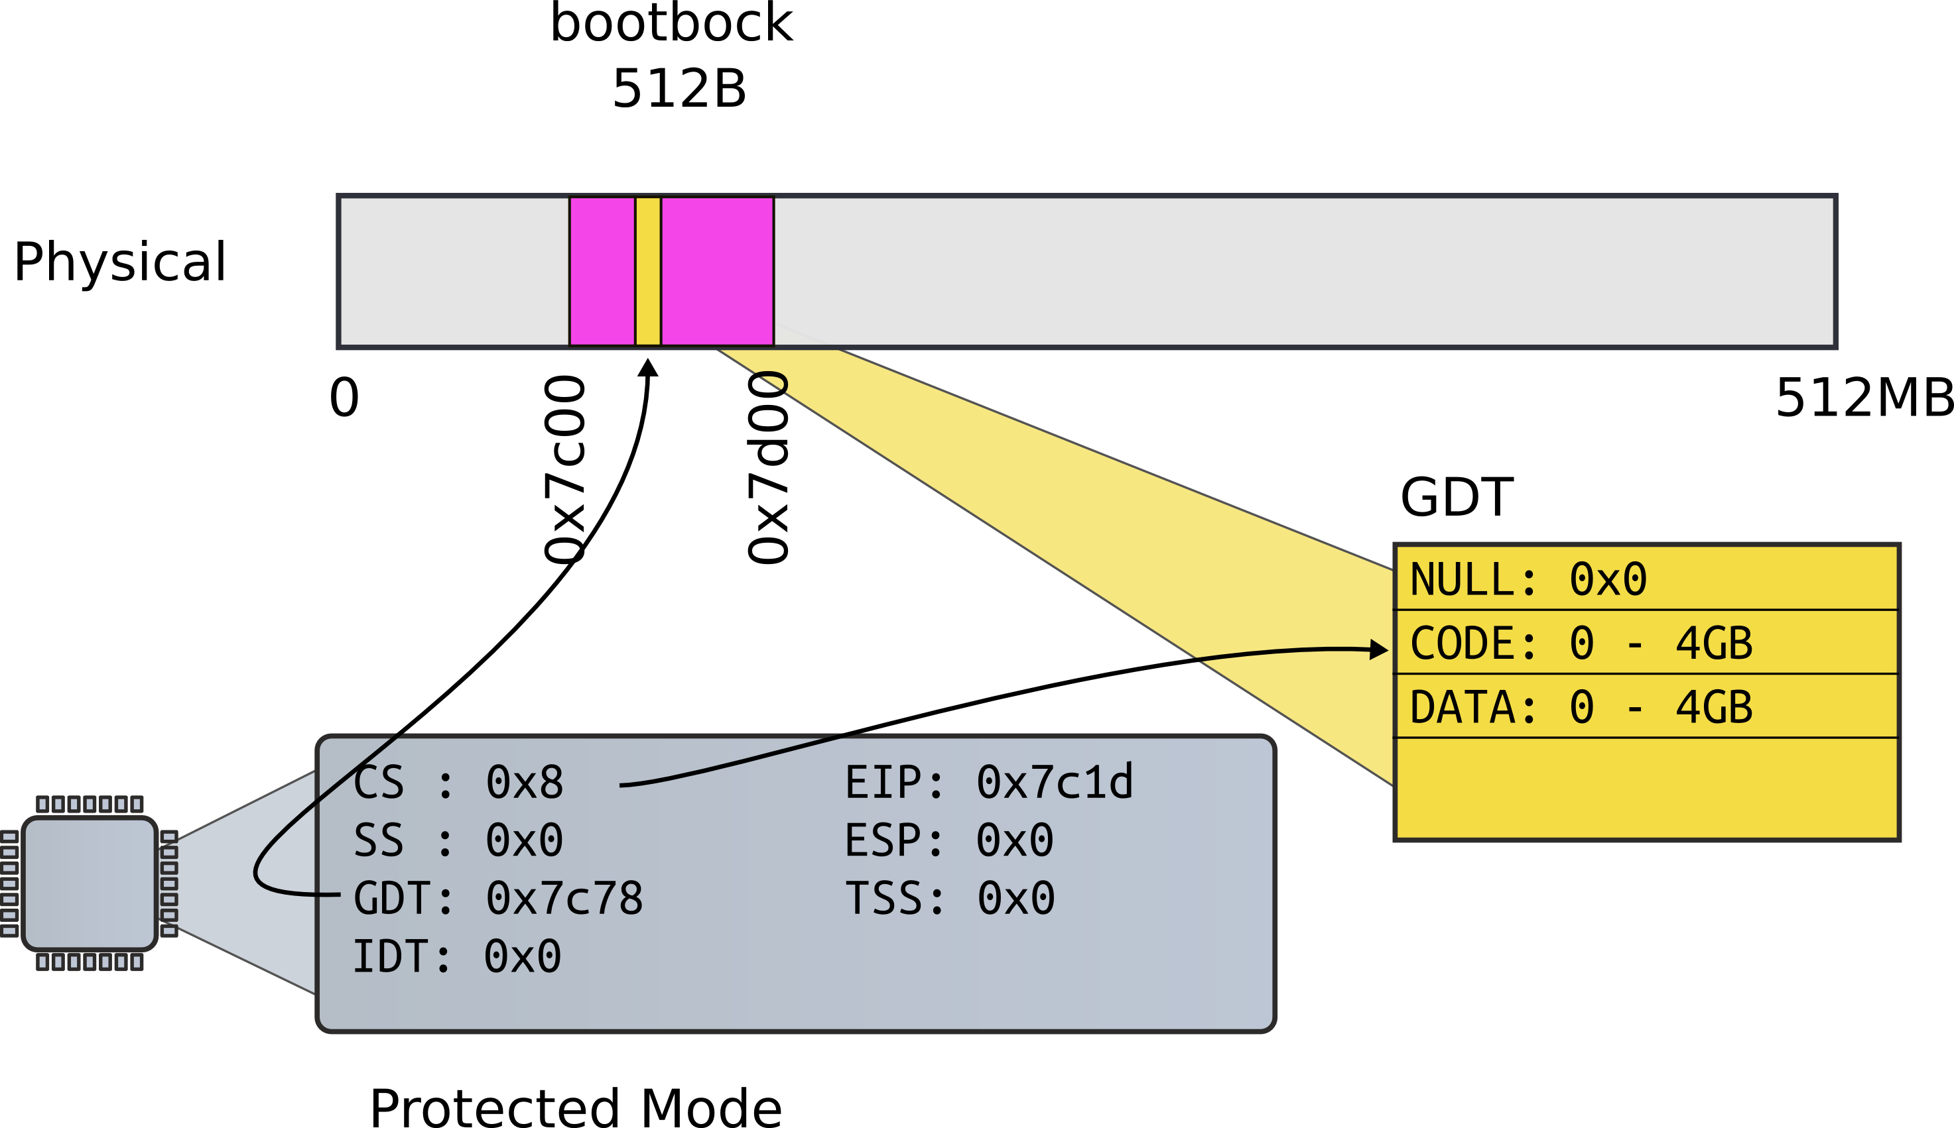
Long jump

Slide 47
Segments
9155 .code32 # Tell assembler to generate 32−bit code now.
9156 start32:
9157 # Set up the protected−mode data segment registers
9158 movw $(SEG_KDATA<<3), %ax # Our data segment selector
9159 movw %ax, %ds # −> DS: Data Segment
9160 movw %ax, %es # −> ES: Extra Segment
9161 movw %ax, %ss # −> SS: Stack Segment
9162 movw $0, %ax # Zero segments not ready for use
9163 movw %ax, %fs # −> FS
9164 movw %ax, %gs # −> GS
xv6/bootasm.S [bootloader]

Slide 48
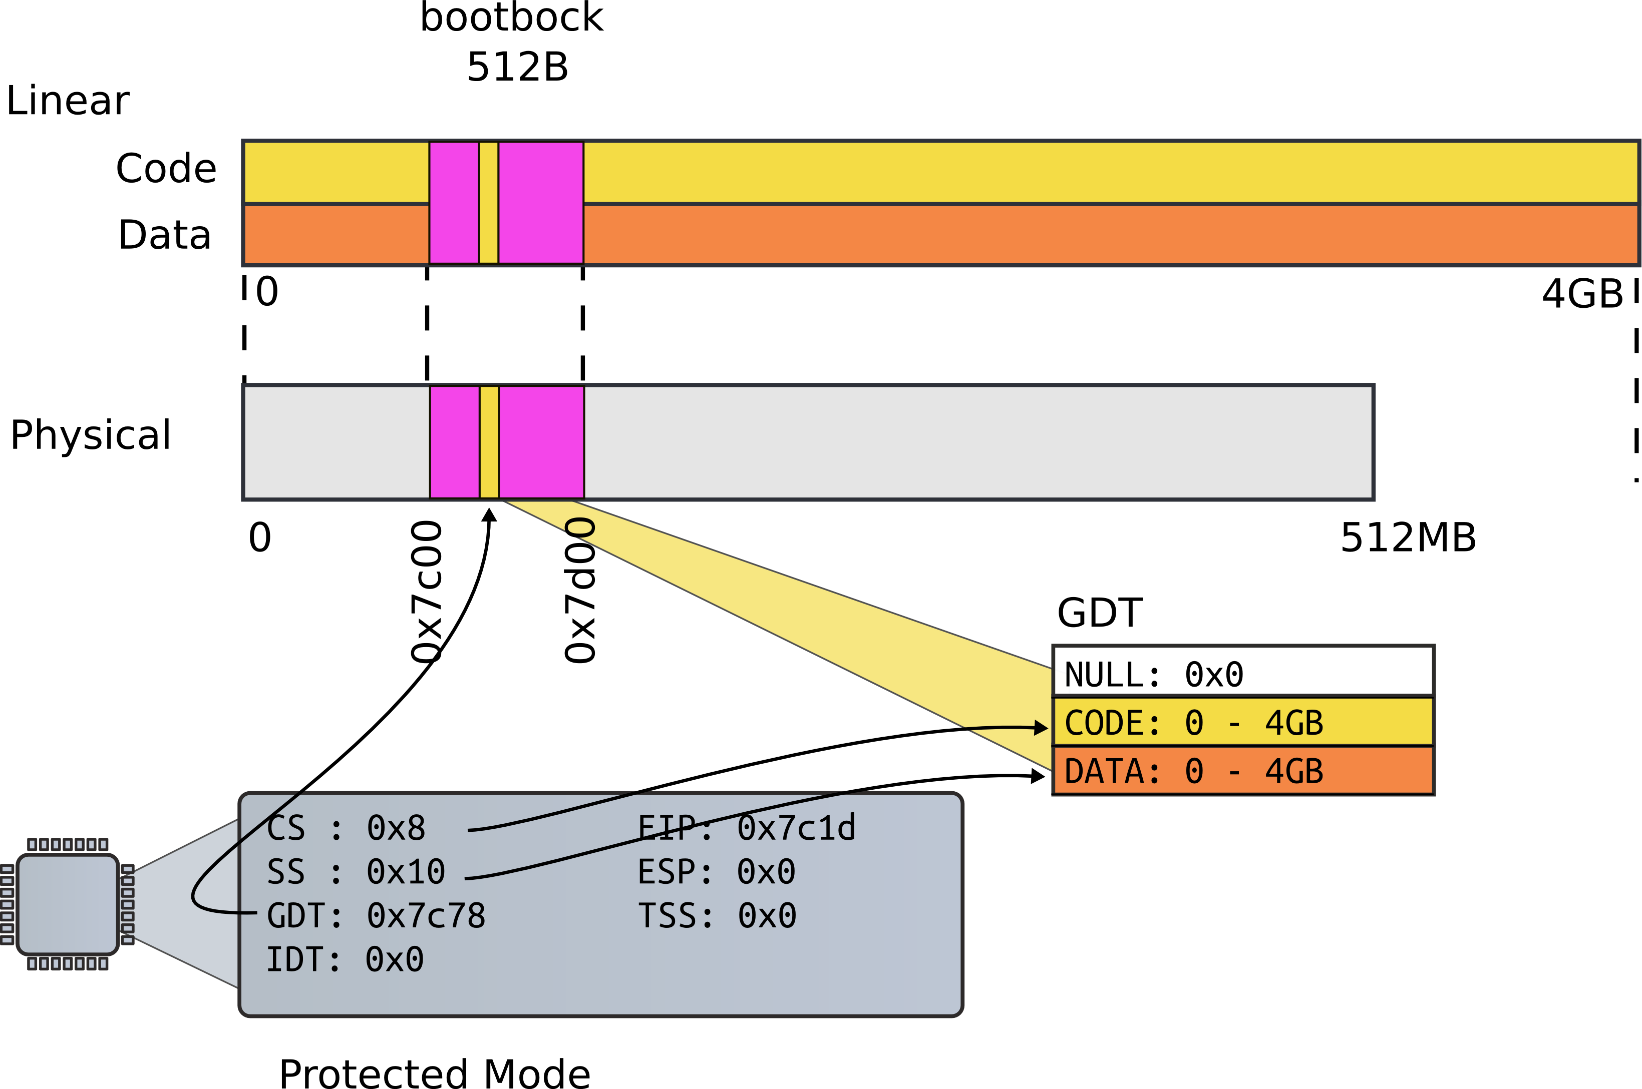
Segments

Slide 49
Setup stack
Why do we need a stack?
9166 movl $start, %esp
9167 call bootmain
xv6/bootasm.S [bootloader]

Slide 50
Setup stack
Need stack to use C
Function invocations
Note, there were no stack instructions before that
9166 movl $start, %esp
9167 call bootmain
xv6/bootasm.S [bootloader]

Slide 51
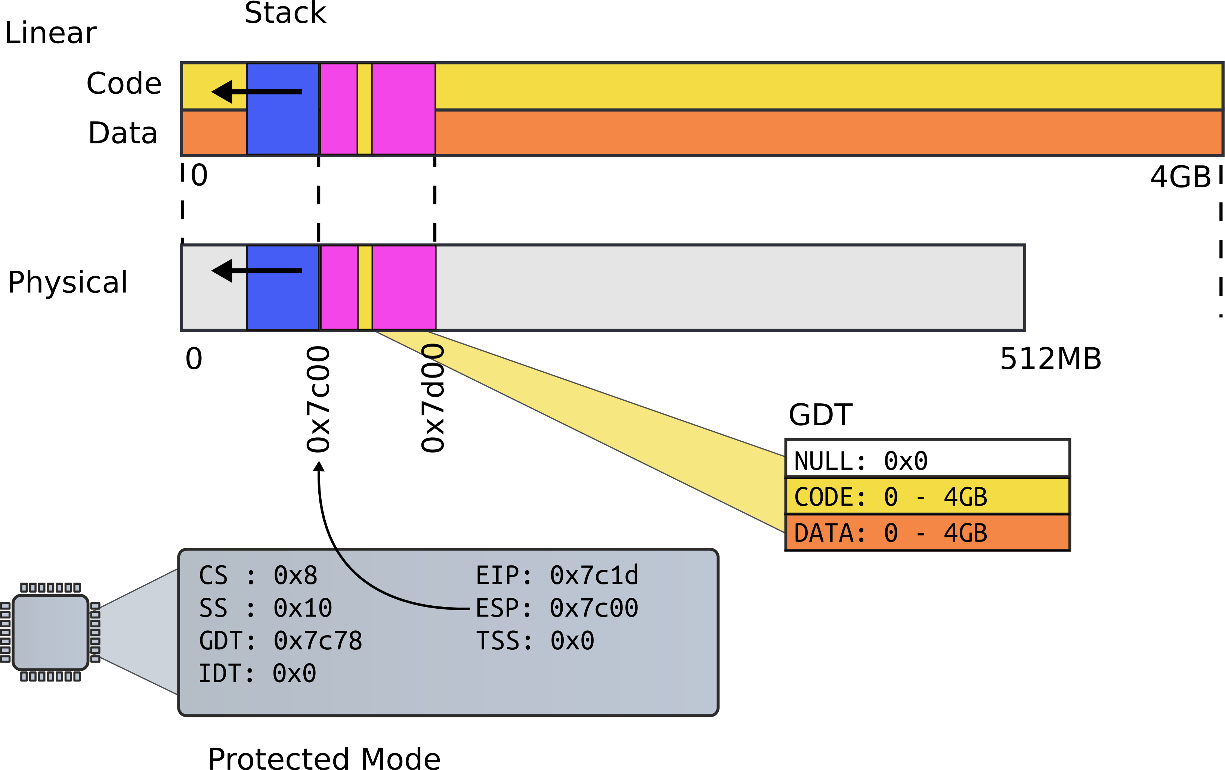
First stack

Slide 52
Invoke first C function
9166 movl $start, %esp
9167 call bootmain
xv6/bootasm.S [bootloader]

Slide 53
bootmain(): read kernel from disk
9216 void
9217 bootmain(void)
9218 {
9219 struct elfhdr *elf;
9220 struct proghdr *ph, *eph;
9221 void (*entry)(void);
9222 uchar* pa;
9223
9224 elf = (struct elfhdr*)0x10000; // scratch space
9225
9226 // Read 1st page off disk
9227 readseg((uchar*)elf, 4096, 0);
9228
9229 // Is this an ELF executable?
9230 if(elf−>magic != ELF_MAGIC)
9231 return; // let bootasm.S handle error
9232
xv6/bootmain.c [bootloader]

Slide 54
bootmain(): read kernel from disk
9232
9233 // Load each program segment (ignores ph flags).
9234 ph = (struct proghdr*)((uchar*)elf + elf−>phoff);
9235 eph = ph + elf−>phnum;
9236 for(; ph < eph; ph++){
9237 pa = (uchar*)ph−>paddr;
9238 readseg(pa, ph−>filesz, ph−>off);
9239 if(ph−>memsz > ph−>filesz)
9240 stosb(pa + ph−>filesz, 0, ph−>memsz − ph−>filesz);
9241 }
9242
9243 // Call the entry point from the ELF header.
9244 // Does not return!
9245 entry = (void(*)(void))(elf−>entry);
9246 entry();
9247 }
xv6/bootmain.c [bootloader]

Slide 55
How do we read disk?
9257
9258 // Read a single sector at offset into dst.
9259 void
9260 readsect(void *dst, uint offset)
9261 {
9262 // Issue command.
9263 waitdisk();
9264 outb(0x1F2, 1); // count = 1
9265 outb(0x1F3, offset);
9266 outb(0x1F4, offset >> 8);
9267 outb(0x1F5, offset >> 16);
9268 outb(0x1F6, (offset >> 24) | 0xE0);
9269 outb(0x1F7, 0x20); // cmd 0x20 − read sectors
9270
9271 // Read data.
9272 waitdisk();
9273 insl(0x1F0, dst, SECTSIZE/4);
9274 }
xv6/bootmain.c [bootloader]

Slide 56
How do we read disk (cont)?
9250 void
9251 waitdisk(void)
9252 {
9253 // Wait for disk ready.
9254 while((inb(0x1F7) & 0xC0) != 0x40)
9255 ;
9256 }
9257
xv6/bootmain.c [bootloader]

Slide 57
How do we read disk?
9257
9258 // Read a single sector at offset into dst.
9259 void
9260 readsect(void *dst, uint offset)
9261 {
9262 // Issue command.
9263 waitdisk();
9264 outb(0x1F2, 1); // count = 1
9265 outb(0x1F3, offset);
9266 outb(0x1F4, offset >> 8);
9267 outb(0x1F5, offset >> 16);
9268 outb(0x1F6, (offset >> 24) | 0xE0);
9269 outb(0x1F7, 0x20); // cmd 0x20 − read sectors
9270
9271 // Read data.
9272 waitdisk();
9273 insl(0x1F0, dst, SECTSIZE/4);
9274 }
xv6/bootmain.c [bootloader]

Slide 58
Call kernel entry
9232
9233 // Load each program segment (ignores ph flags).
9234 ph = (struct proghdr*)((uchar*)elf + elf−>phoff);
9235 eph = ph + elf−>phnum;
9236 for(; ph < eph; ph++){
9237 pa = (uchar*)ph−>paddr;
9238 readseg(pa, ph−>filesz, ph−>off);
9239 if(ph−>memsz > ph−>filesz)
9240 stosb(pa + ph−>filesz, 0, ph−>memsz − ph−>filesz);
9241 }
9242
9243 // Call the entry point from the ELF header.
9244 // Does not return!
9245 entry = (void(*)(void))(elf−>entry);
9246 entry();
9247 }
xv6/bootmain.c [bootloader]

Slide 59
entry(): kernel ELF entry
1039 .globl entry
1136 # By convention, the _start symbol specifies the ELF entry point.
1137 # Since we haven’t set up virtual memory yet, our entry point is
1138 # the physical address of ’entry’.
1139 .globl _start
1140 _start = V2P_WO(entry)
1141
1142 # Entering xv6 on boot processor, with paging off.
1143 .globl entry
1144 entry:
1145 # Turn on page size extension for 4Mbyte pages
1146 movl %cr4, %eax
1147 orl $(CR4_PSE), %eax
1148 movl %eax, %cr4
xv6/entry.S [kernel]

Slide 60
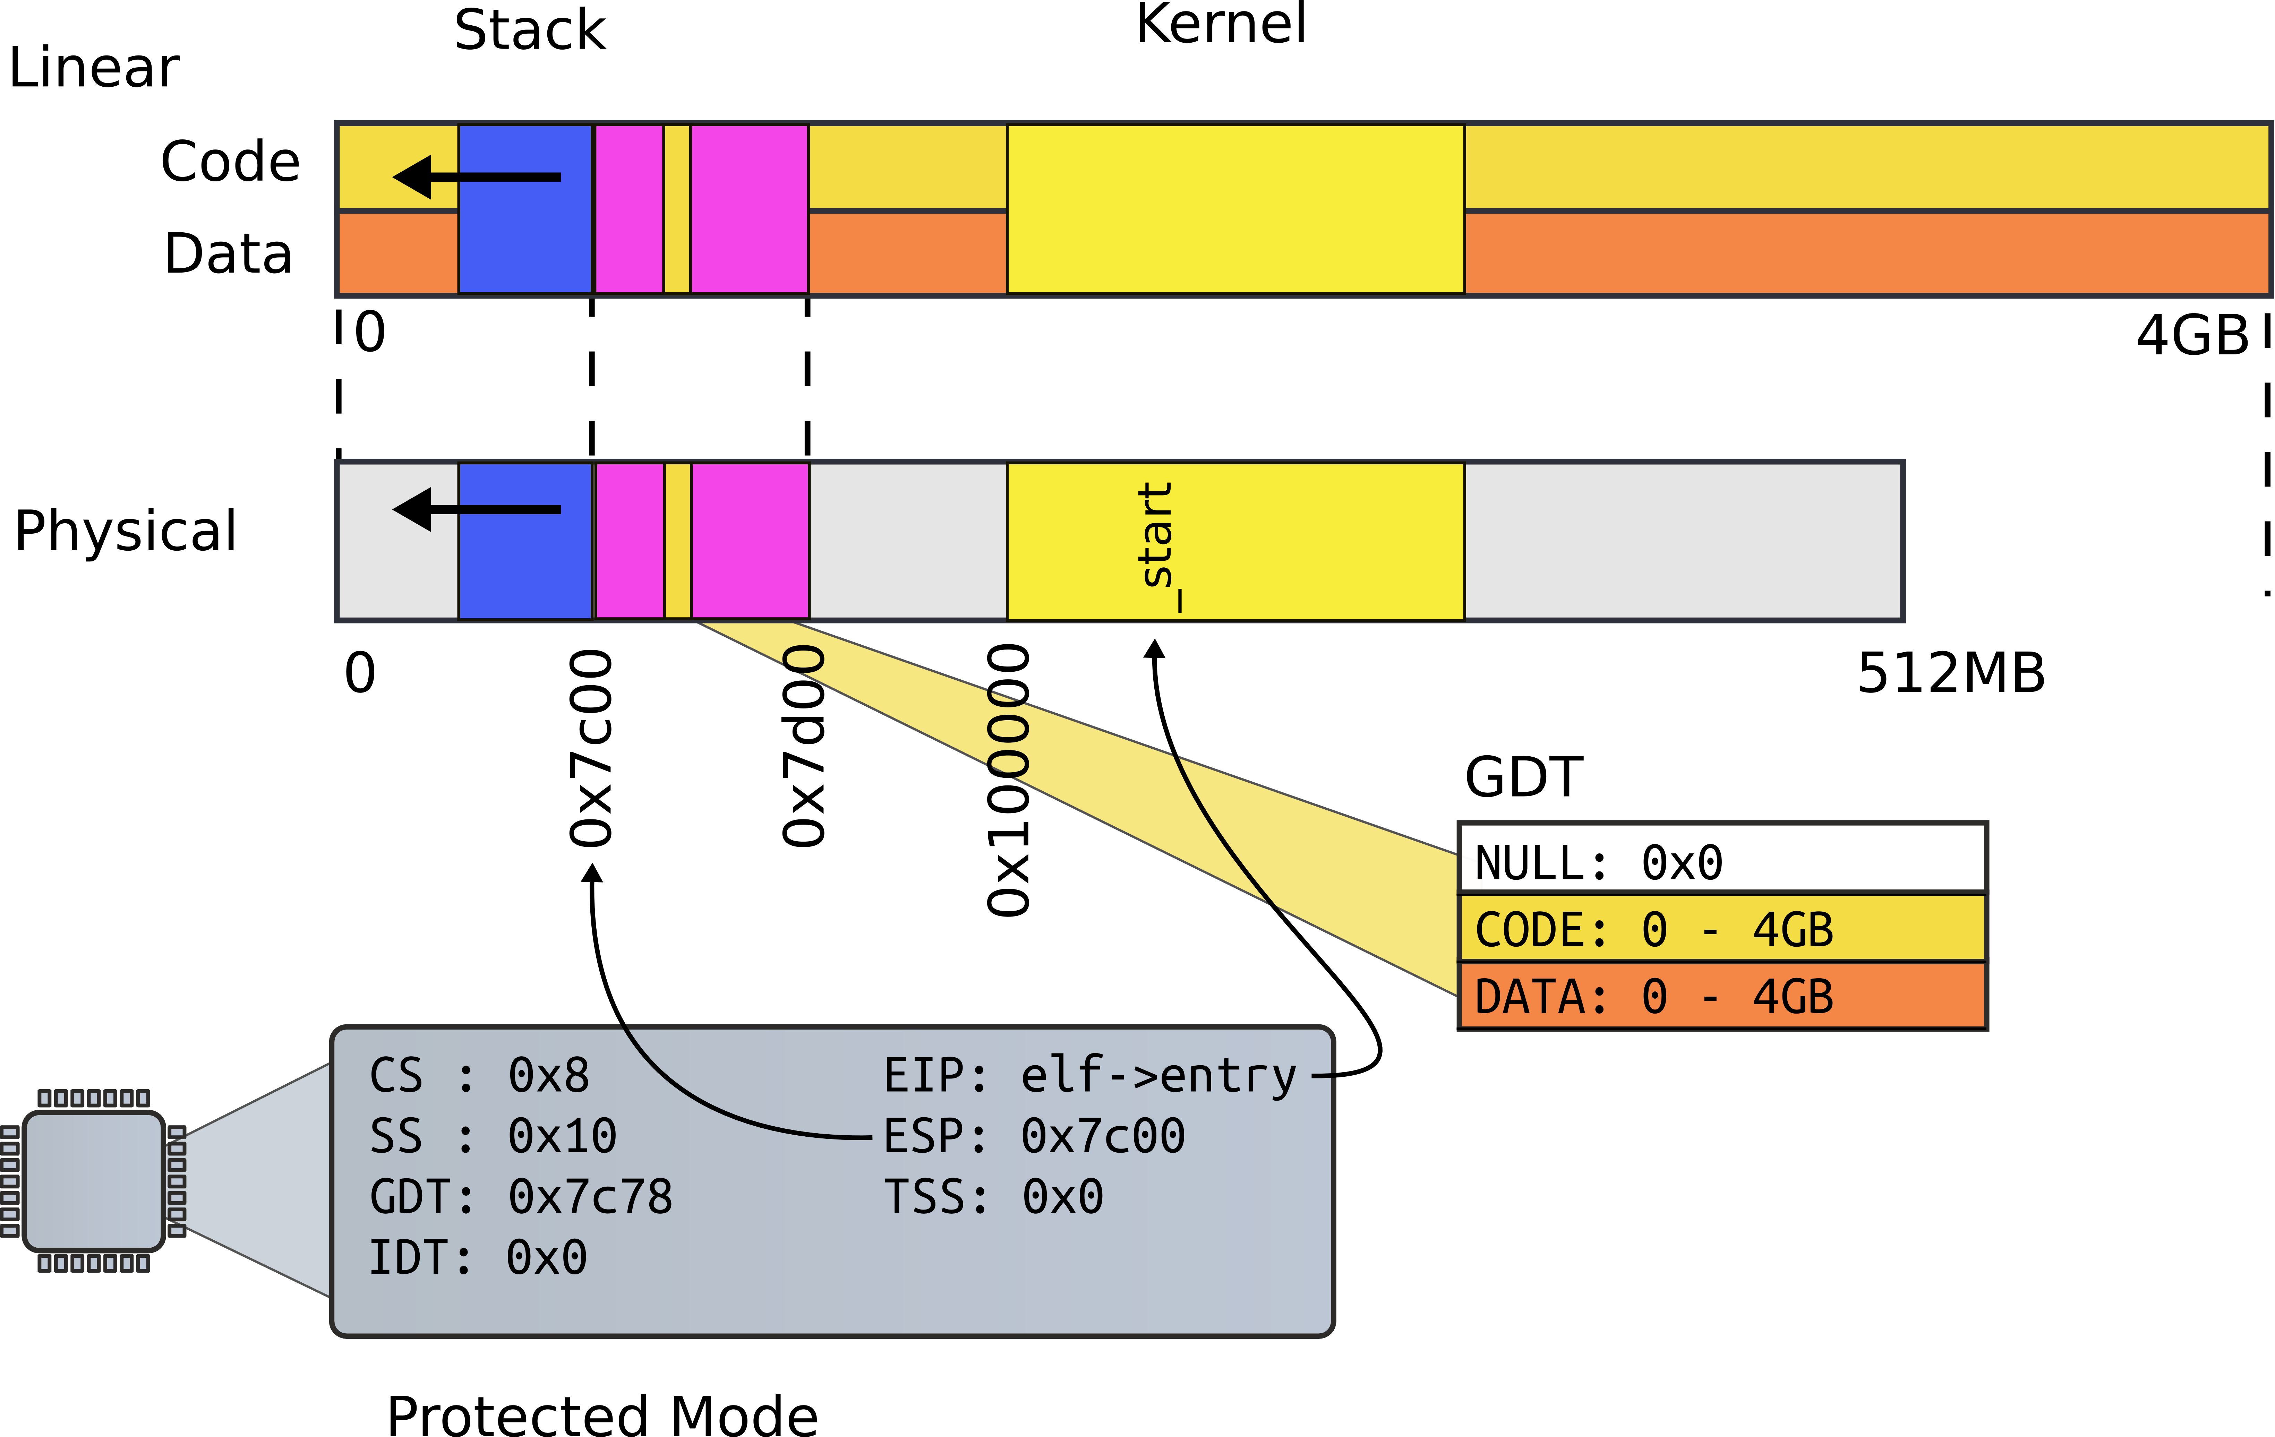
Kernel

Slide 61
entry(): kernel ELF entry
1039 .globl entry
1136 # By convention, the _start symbol specifies the ELF entry point.
1137 # Since we haven’t set up virtual memory yet, our entry point is
1138 # the physical address of ’entry’.
1139 .globl _start
1140 _start = V2P_WO(entry)
1141
1142 # Entering xv6 on boot processor, with paging off.
1143 .globl entry
1144 entry:
1145 # Turn on page size extension for 4Mbyte pages
1146 movl %cr4, %eax
1147 orl $(CR4_PSE), %eax
1148 movl %eax, %cr4
xv6/entry.S [kernel]

Slide 62
32bit x86 supports two page sizes
4KB pages
4MB pages

Slide 63
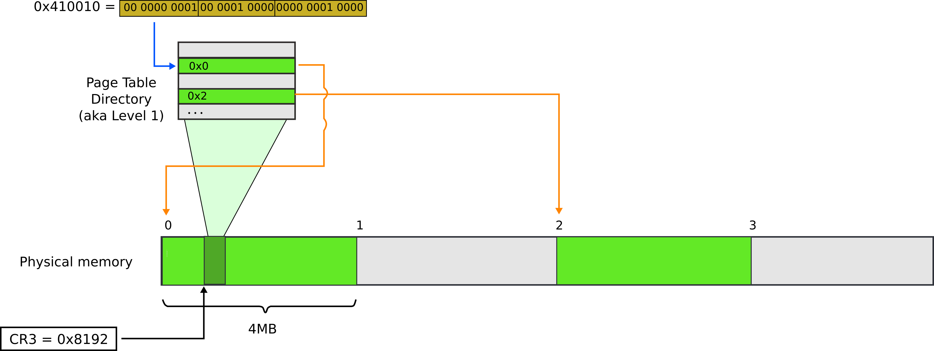
Page translation for 4MB pages

Slide 64
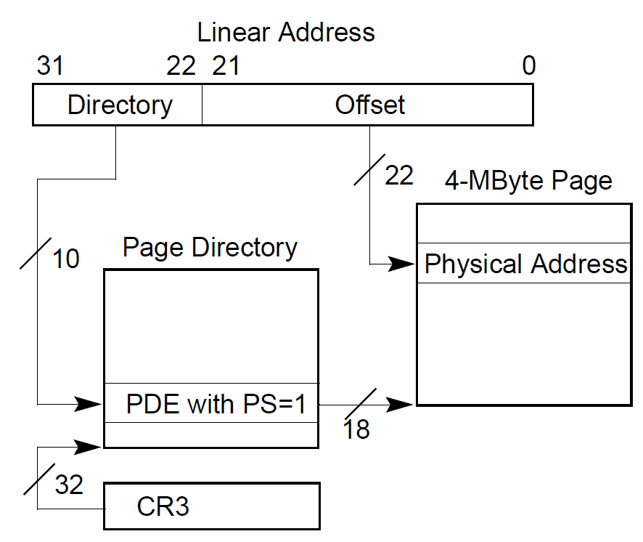
Page translation for 4MB pages

Slide 65
Set up page directory
1149 # Set page directory
1150 movl $(V2P_WO(entrypgdir)), %eax
1151 movl %eax, %cr3
xv6/entry.S [kernel]

Slide 66
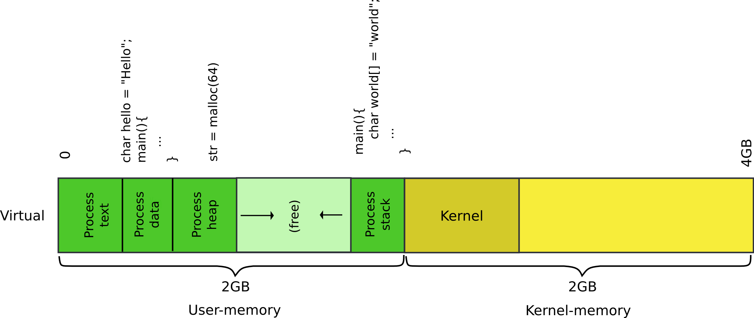
Our goal: 2GB/2GB address space

Slide 67
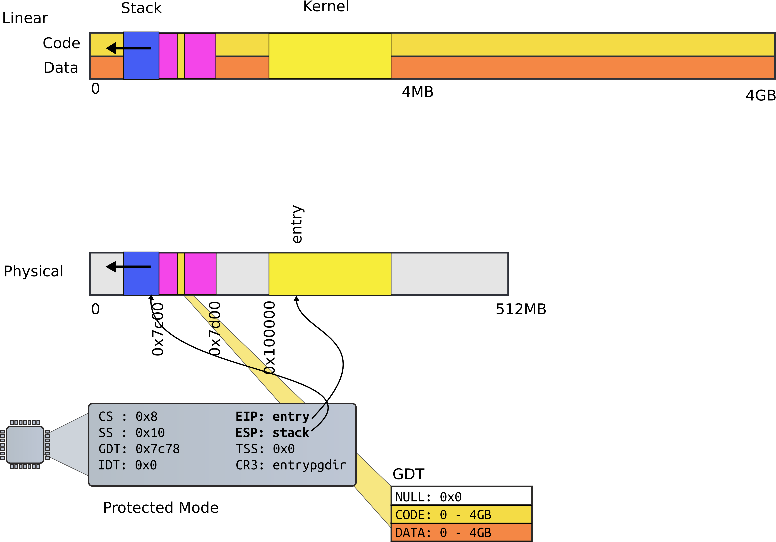

Slide 68
First page table
Two 4MB entries (large pages)
Entry #0
0x0 – 4MB → 0x0:0x400000
Entry #512
0x0 – 4MB → 0x8000000:0x80400000

Slide 69
First page table
1406 // The boot page table used in entry.S and entryother.S.
1407 // Page directories (and page tables) must start on page boundaries,
1408 // hence the __aligned__ attribute.
1409 // PTE_PS in a page directory entry enables 4Mbyte pages.
1410
1411 __attribute__((__aligned__(PGSIZE)))
1412 pde_t entrypgdir[NPDENTRIES] = {
1413 // Map VA’s [0, 4MB) to PA’s [0, 4MB)
1414 [0] = (0) | PTE_P | PTE_W | PTE_PS,
1415 // Map VA’s [KERNBASE, KERNBASE+4MB) to PA’s [0, 4MB)
1416 [KERNBASE>>PDXSHIFT] = (0) | PTE_P | PTE_W | PTE_PS,
1417 };

Slide 70
First page table
1406 // The boot page table used in entry.S and entryother.S.
1407 // Page directories (and page tables) must start on page boundaries,
1408 // hence the __aligned__ attribute.
1409 // PTE_PS in a page directory entry enables 4Mbyte pages.
1410
1411 __attribute__((__aligned__(PGSIZE)))
1412 pde_t entrypgdir[NPDENTRIES] = {
1413 // Map VA’s [0, 4MB) to PA’s [0, 4MB)
1414 [0] = (0) | PTE_P | PTE_W | PTE_PS,
1415 // Map VA’s [KERNBASE, KERNBASE+4MB) to PA’s [0, 4MB)
1416 [KERNBASE>>PDXSHIFT] = (0) | PTE_P | PTE_W | PTE_PS,
1417 };

Slide 71
First page table (cont)
0870 // Page directory and page table constants.
0871 #define NPDENTRIES 1024

Slide 72
First page table
1406 // The boot page table used in entry.S and entryother.S.
1407 // Page directories (and page tables) must start on page boundaries,
1408 // hence the __aligned__ attribute.
1409 // PTE_PS in a page directory entry enables 4Mbyte pages.
1410
1411 __attribute__((__aligned__(PGSIZE)))
1412 pde_t entrypgdir[NPDENTRIES] = {
1413 // Map VA’s [0, 4MB) to PA’s [0, 4MB)
1414 [0] = (0) | PTE_P | PTE_W | PTE_PS,
1415 // Map VA’s [KERNBASE, KERNBASE+4MB) to PA’s [0, 4MB)
1416 [KERNBASE>>PDXSHIFT] = (0) | PTE_P | PTE_W | PTE_PS,
1417 };

Slide 73
First page table
1406 // The boot page table used in entry.S and entryother.S.
1407 // Page directories (and page tables) must start on page boundaries,
1408 // hence the __aligned__ attribute.
1409 // PTE_PS in a page directory entry enables 4Mbyte pages.
1410
1411 __attribute__((__aligned__(PGSIZE)))
1412 pde_t entrypgdir[NPDENTRIES] = {
1413 // Map VA’s [0, 4MB) to PA’s [0, 4MB)
1414 [0] = (0) | PTE_P | PTE_W | PTE_PS,
1415 // Map VA’s [KERNBASE, KERNBASE+4MB) to PA’s [0, 4MB)
1416 [KERNBASE>>PDXSHIFT] = (0) | PTE_P | PTE_W | PTE_PS,
1417 };

Slide 74
First page table
1406 // The boot page table used in entry.S and entryother.S.
1407 // Page directories (and page tables) must start on page boundaries,
1408 // hence the __aligned__ attribute.
1409 // PTE_PS in a page directory entry enables 4Mbyte pages.
1410
1411 __attribute__((__aligned__(PGSIZE)))
1412 pde_t entrypgdir[NPDENTRIES] = {
1413 // Map VA’s [0, 4MB) to PA’s [0, 4MB)
1414 [0] = (0) | PTE_P | PTE_W | PTE_PS,
1415 // Map VA’s [KERNBASE, KERNBASE+4MB) to PA’s [0, 4MB)
1416 [KERNBASE>>PDXSHIFT] = (0) | PTE_P | PTE_W | PTE_PS,
1417 };

Slide 75
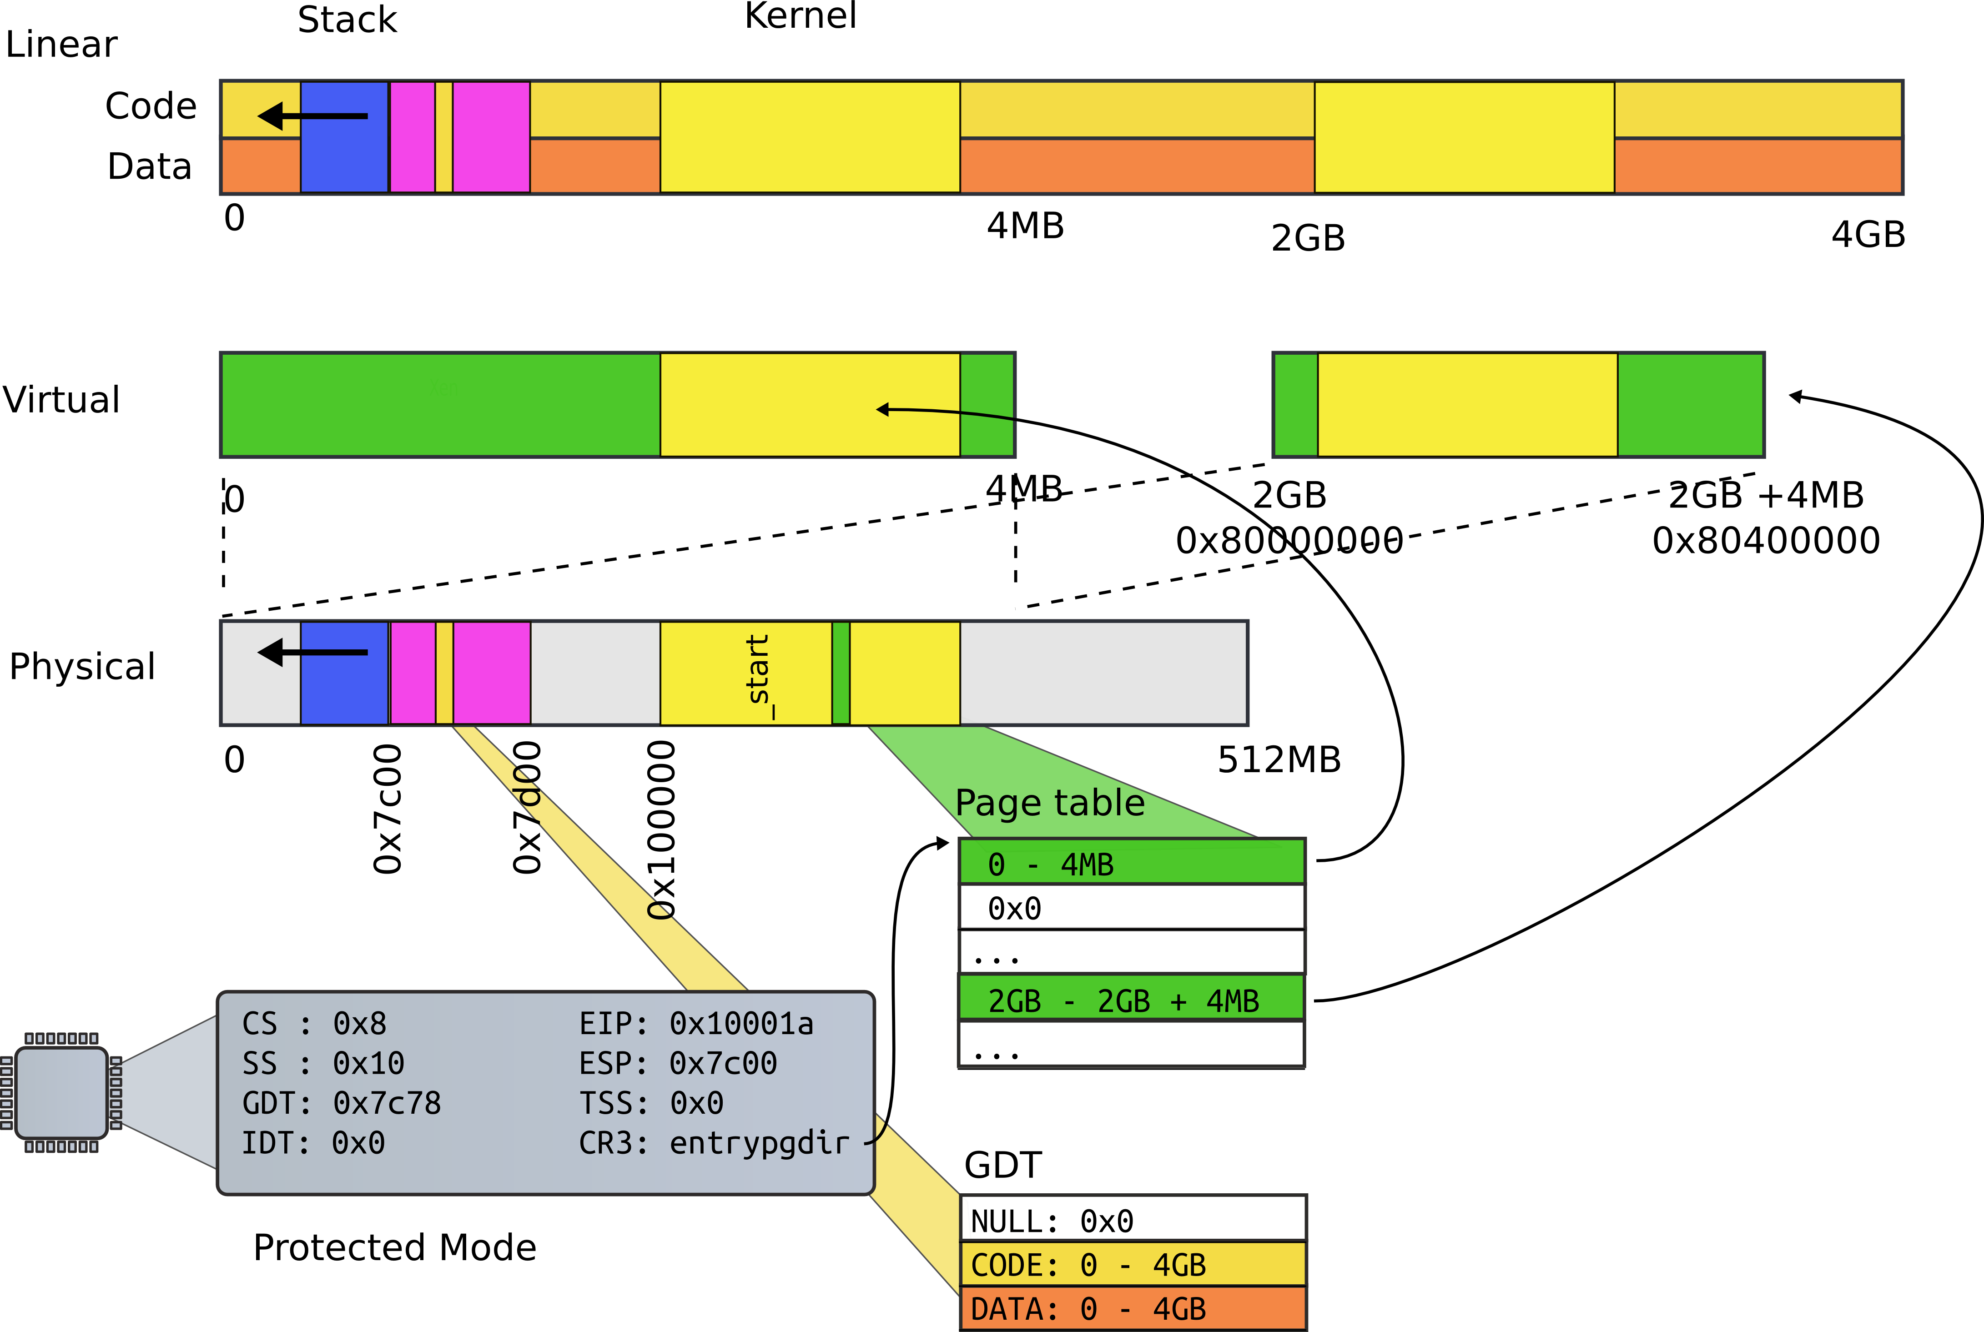
First page table

Slide 76
Turn on paging
1152 # Turn on paging.
1153 movl %cr0, %eax
1154 orl $(CR0_PG|CR0_WP), %eax
1155 movl %eax, %cr0
xv6/entry.S [kernel]

Slide 77
High address stack (4K)
1157 # Set up the stack pointer.
1158 movl $(stack + KSTACKSIZE), %esp
1159
...
1167 .comm stack, KSTACKSIZE
0151 #define KSTACKSIZE 4096 // size of
per−process kernel stack
xv6/entry.S [kernel]

Slide 78
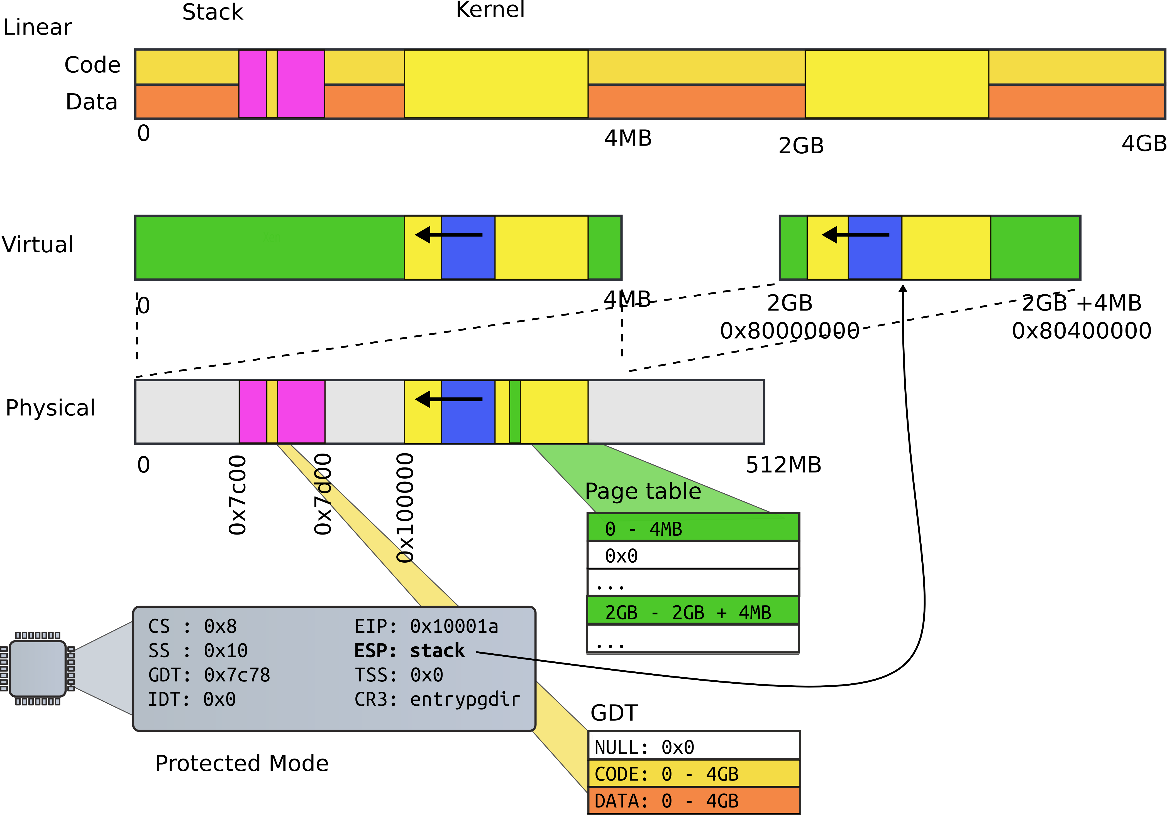
High address stack (4K)

Slide 79
Jump to main()
1160 # Jump to main(), and switch to executing at
1161 # high addresses. The indirect call is
needed because
1162 # the assembler produces a PC−relative
instruction
1163 # for a direct jump.
1164 mov $main, %eax
1165 jmp *%eax
1166
xv6/entry.S [kernel]

Slide 80
Running in main()
1313 // Bootstrap processor starts running C code here.
1314 // Allocate a real stack and switch to it, first
1315 // doing some setup required for memory allocator to work.
1316 int
1317 main(void)
1318 {
1319 kinit1(end, P2V(4*1024*1024)); // phys page allocator
1320 kvmalloc(); // kernel page table
1321 mpinit(); // detect other processors
1322 lapicinit(); // interrupt controller
1323 seginit(); // segment descriptors
1324 cprintf("\ncpu%d: starting xv6\n\n", cpunum());
...
1340 }
xv6/main.c [kernel]

Slide 81
Recap of the boot sequence
Setup segments (data and code)
Switched to protected mode
Loaded GDT (segmentation is on)
Setup stack (to call C functions)
Loaded kernel from disk
Setup first page table
2 entries [ 0 : 4MB ] and [ 2GB : (2GB + 4MB) ]
Setup high-address stack
Jumped to main()

Slide 82
Conclusion
We've booted
We're running in main()

Slide 83
Thank you!

Slide 84
References
[1] Costan, Victor, and Srinivas Devadas. "Intel SGX Explained." IACR Cryptology ePrint Archive 2016 (2016): 86. https://eprint.iacr.org/2016/086.pdf

Slide 85
Function pointers
#include <stdio.h>
void func_a(void){
printf("func_a\n");
return;
}
void func_b(void) {
printf("func_b\n");
return;
}
int main(int ac, char **av)
{
void (*fp)(void);
fp = func_b;
fp();
return;
}

Slide 86
Function pointers
08048432 <func_b>:
8048432: 55 push %ebp
8048433: 89 e5 mov %esp,%ebp
8048435: 83 ec 18 sub $0x18,%esp
8048438: c7 04 24 07 85 04 08 movl $0x8048507,(%esp)
804843f: e8 ac fe ff ff call 80482f0 <puts@plt>
8048444: 90 nop
8048445: c9 leave
8048446: c3 ret
08048447 <main>:
8048447: 55 push %ebp
8048448: 89 e5 mov %esp,%ebp
804844a: 83 e4 f0 and $0xfffffff0,%esp
804844d: 83 ec 10 sub $0x10,%esp
# Load pointer to func_p on the stack
8048450: c7 44 24 0c 32 84 04 movl $0x8048432,0xc(%esp)
8048457: 08
8048458: 8b 44 24 0c mov 0xc(%esp),%eax
804845c: ff d0 call *%eax
804845e: 90 nop
804845f: c9 leave
8048460: c3 ret

Slide 87
Function pointers
08048432 <func_b>:
8048432: 55 push %ebp
8048433: 89 e5 mov %esp,%ebp
8048435: 83 ec 18 sub $0x18,%esp
8048438: c7 04 24 07 85 04 08 movl $0x8048507,(%esp)
804843f: e8 ac fe ff ff call 80482f0 <puts@plt>
8048444: 90 nop
8048445: c9 leave
8048446: c3 ret
08048447 <main>:
8048447: 55 push %ebp
8048448: 89 e5 mov %esp,%ebp
804844a: 83 e4 f0 and $0xfffffff0,%esp
804844d: 83 ec 10 sub $0x10,%esp
# Load pointer to func_p on the stack
8048450: c7 44 24 0c 32 84 04 movl $0x8048432,0xc(%esp)
8048457: 08
# Move func_b into %eax
8048458: 8b 44 24 0c mov 0xc(%esp),%eax
804845c: ff d0 call *%eax # Call %eax
804845e: 90 nop
804845f: c9 leave
8048460: c3 ret

